Slide 1
Final Project Phase III
Midwest Project Group
Mallik Challa, Mark Johnson, Xin Gu, Sina Kianersi
Notes:
DSADSAdsafdsafds

Slide 2
Introduction
SECTION 1

Slide 3
Competition and problem explanation
Introduction
Home Credit Default Risk (HCDR):
Home Credit, a Eurasian consumer finance provider, seeks to provide lending opportunities to this underserved population with less or no credit history.
Challenge:
Identify clients repayment capability.

Slide 4
Project aim
Introduction
Aim ➔ In this project, we aim to predict the repayment capabilities of Home Credit clients with a high precision.
Prediction evaluation ➔ area under the ROC curve

Slide 5
Data Description
SECTION 2

Slide 6
Home Credit dataset
Data Description
Data for this project is from Home Credit Kaggle competition; https://www.kaggle.com/c/home-credit-default-risk/data
There are seven csv files in the dataset
Target: 1 = Client with payment difficulties, 0 = otherwise

Slide 7
Data files
Data Description
Test: 48.7k x 121
application_train|test
Train: 308k x 122
bureau
1.72m x 17
bureau_balance
27.3m x 3
POS_CASH_balance
10.0m x 8
credit_card_balance
3.84 x 23
previous_application
1.67m x 37
installments_payments
13.6m x 8

Slide 8
Exploratory Data Analysis
SECTION 3

Slide 9
EDA: Missing patterns
EDA
Many features have missing values
This can notably influence our prediction, particularly if the missing pattern is not at random.
In the following slides, we look at some of the important features with many missing values.

Slide 10
Features with most missing values in application train/test
EDA
Train
Test
Feature | Percent | Count
COMMONAREA_MEDI | 69.87 | 214865
COMMONAREA_AVG | 69.87 | 214865
COMMONAREA_MODE | 69.87 | 214865
NONLIVINGAPARTMENTS_MODE | 69.43 | 213514
NONLIVINGAPARTMENTS_MEDI | 69.43 | 213514
COMMONAREA_AVG | 69.87 | 214865
Feature | Percent | Count
COMMONAREA_MEDI | 68.72 | 33495
COMMONAREA_AVG | 68.72 | 33495
COMMONAREA_MODE | 68.72 | 33495
NONLIVINGAPARTMENTS_MODE | 68.41 | 33347
NONLIVINGAPARTMENTS_MEDI | 68.41 | 33347
COMMONAREA_MEDI | 68.72 | 33495

Slide 11
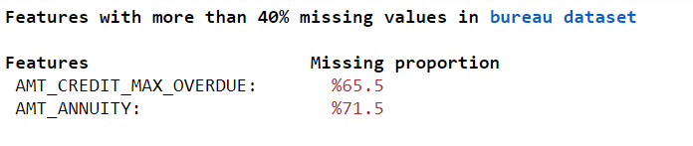
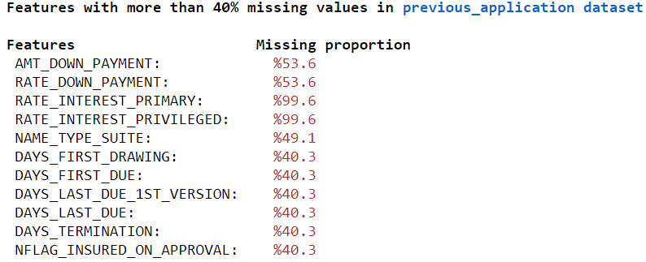
Proportion of missing values for columns with more than 40% in other datasets
EDA
The following datasets did not have such features: bureau_balance, credit_card_balance, and installments_payments

Slide 12
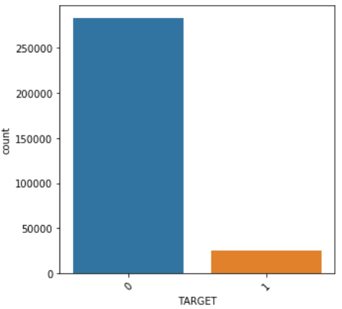
EDA: Target feature
EDA
Value counts: 24,825 (8%) clients had payment difficulties (out of 307,511 clients).
Target variable distribution shows that the dataset is highly imbalanced.

Slide 13
EDA: Feature datatypes
EDA
Breakdown of application dataset feature datatypes
float64 65
int64 41
object 16
Categorical features in application dataset
['NAME_CONTRACT_TYPE', 'CODE_GENDER', 'FLAG_OWN_CAR', 'FLAG_OWN_REALTY', 'NAME_TYPE_SUITE’,
'NAME_INCOME_TYPE’,'NAME_EDUCATION_TYPE', 'NAME_FAMILY_STATUS', 'NAME_HOUSING_TYPE’,
'OCCUPATION_TYPE', 'WEEKDAY_APPR_PROCESS_START’,'ORGANIZATION_TYPE', 'FONDKAPREMONT_MODE’,
'HOUSETYPE_MODE', 'WALLSMATERIAL_MODE', 'EMERGENCYSTATE_MODE']

Slide 14
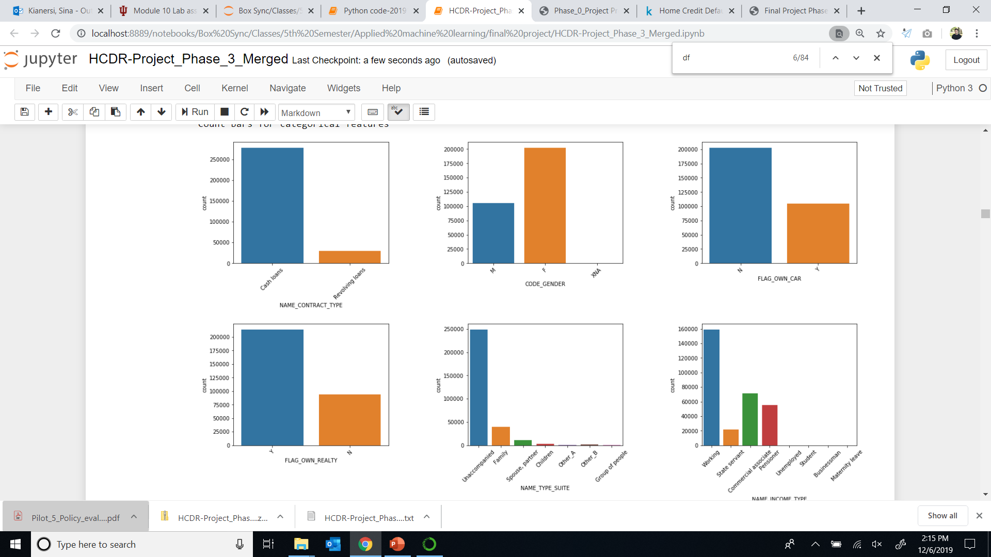
EDA: Countbars for some of the categorical features
EDA

Slide 15
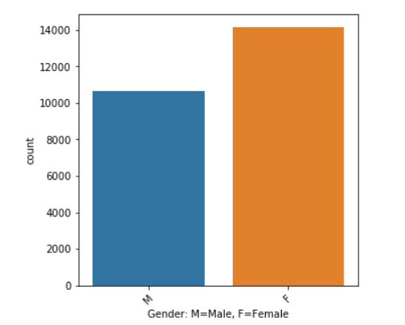
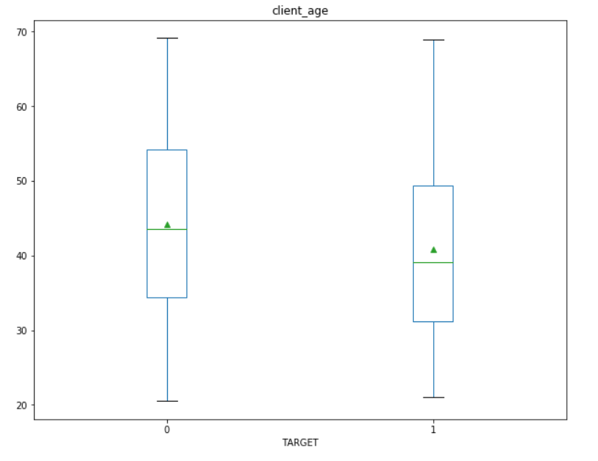
EDA: Target by features
EDA
Count bar for gender where target==1
Age box plots by Target status

Slide 16
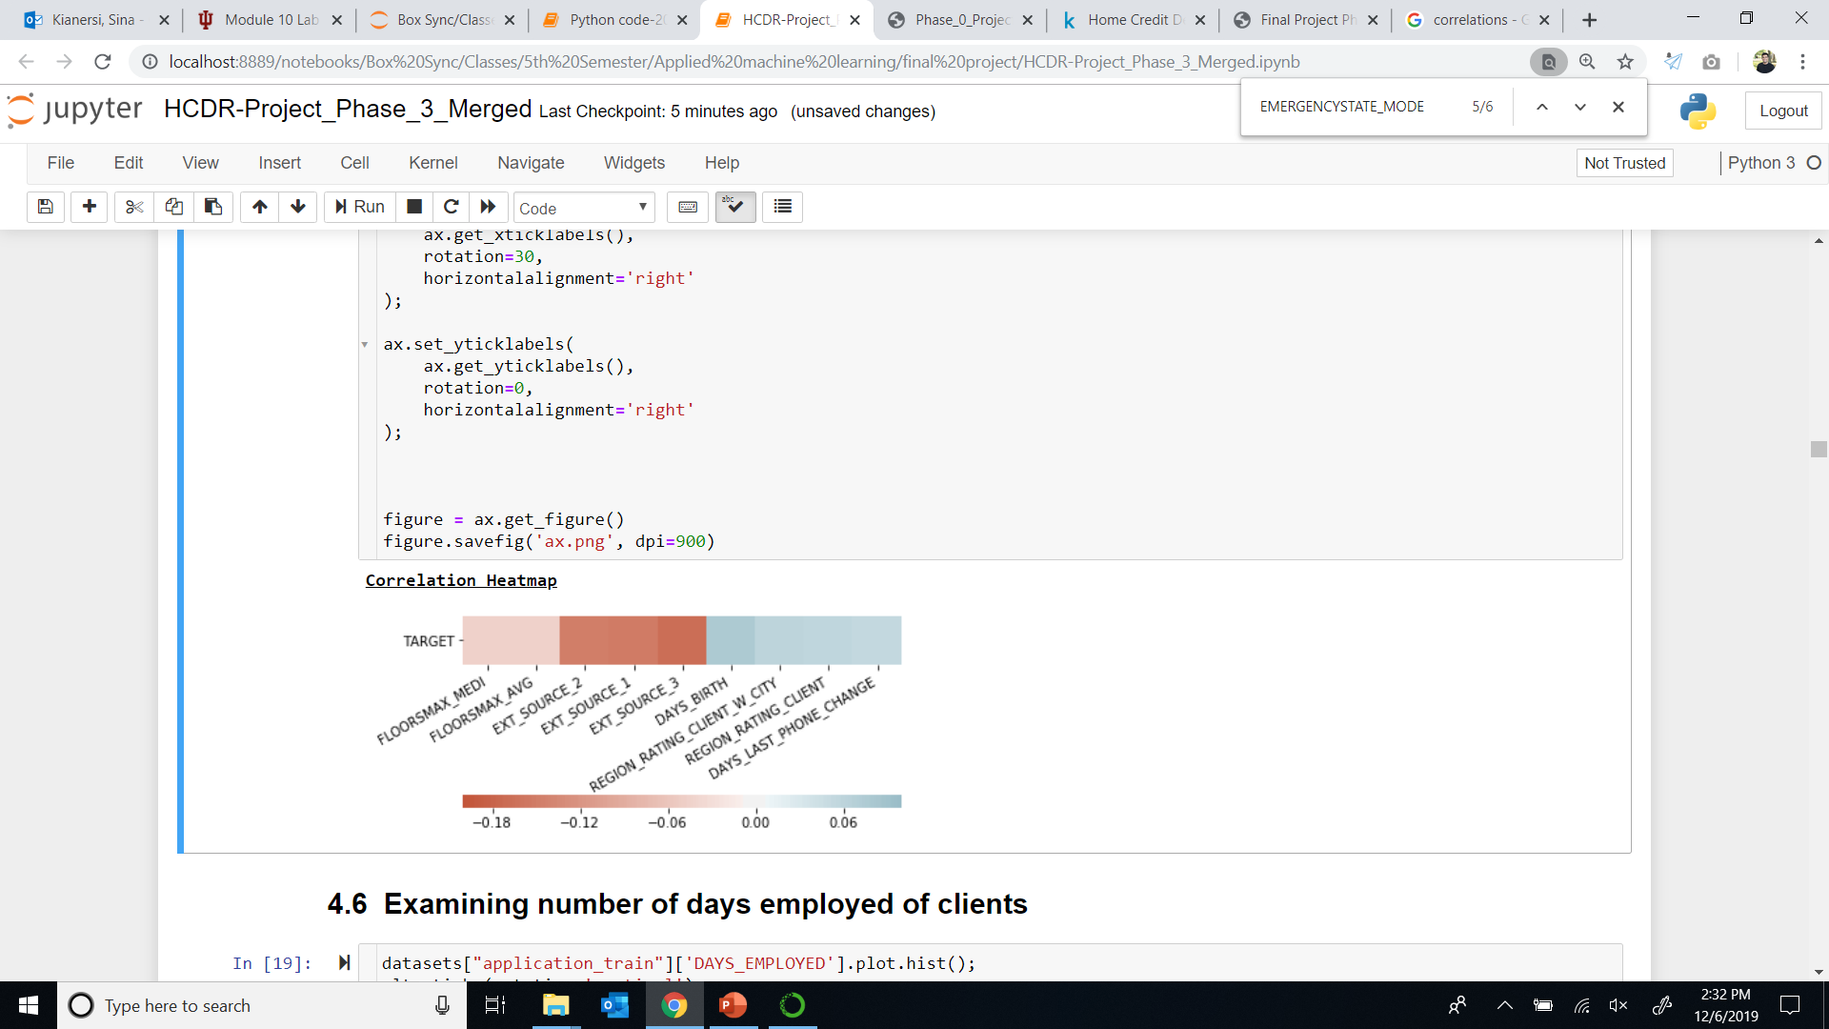
Correlation heatmap
Basic Model
Features that are highly correlated with the target.
EXT_SOURCE_1, EXT_SOURCE_2, and EXT_SOURCE_3 are highly and negatively correlated with the target.

Slide 17
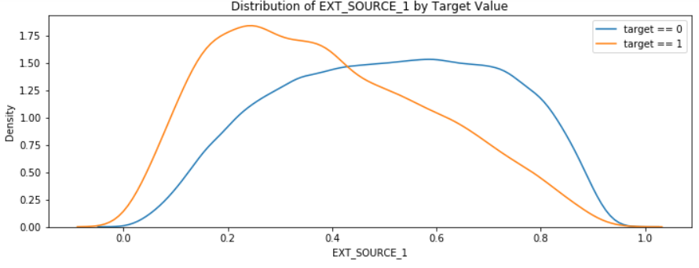
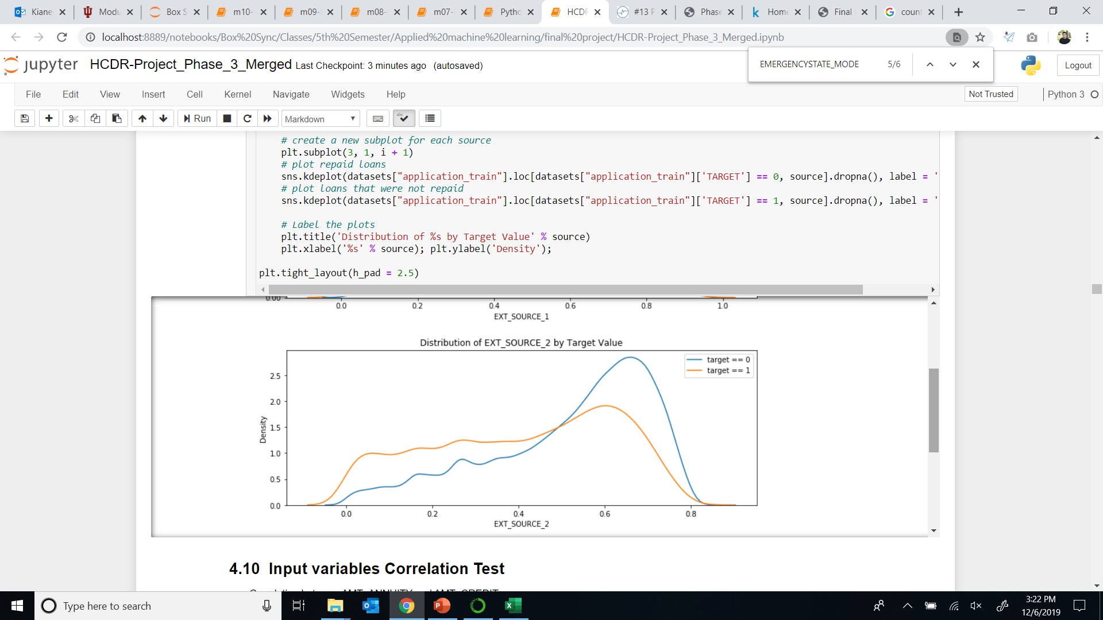
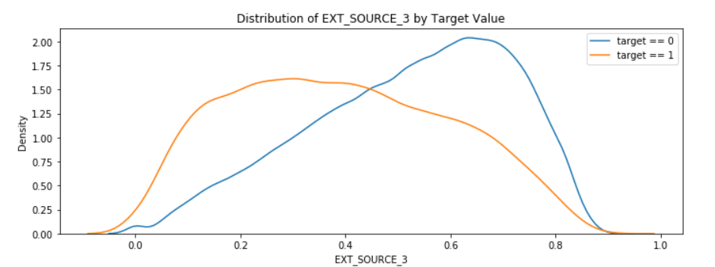
EDA: Density Plot for External Sources by target status
EDA
EXT_SOURCE_1, EXT_SOURCE_2, and EXT_SOURCE_3 are highly and negatively correlated with the target.

Slide 18
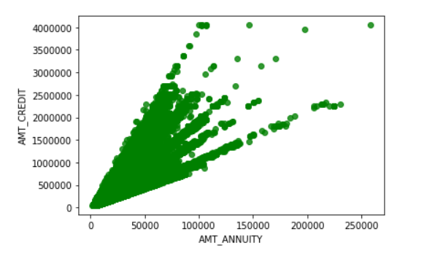
EDA: Input variables Correlation Test
EDA
From the above plot, the variables AMT_ANUITY and AMT_CREDIT seem to be positively correlated. One of features can be excluded from the final list of input features

Slide 19
EDA results
EDA
There are many missing values for some important features. This requires a sophisticated imputation procedure. Further, for many variables, the values seem to largely differ based on TARGET status.
Those with loan repayment difficulties (Target=1) are mostly female (57%), compare to (42% male).
Older clients tend to repay the loans more frequently compared to younger clients
EXT_SOURCE_1 and EXT_SOURCE_3 show less score related higher failure in repaying loans. EXT_SOURCE_2 does not show obvious difference but it agrees with lower score pointing to high failure rate.
More details about EDA for other features and datasets are included in the notebook.

Slide 20
Imputation and PCA
SECTION 4

Slide 21
Imputation
Imputation
Four imputation strategies:
SimpleImputer (strategy='mean’) for numeric features
SimpleImputer (strategy=‘median’) for numeric features which have high number of outliers.
SimpleImputer (strategy='most_frequent’) for categorical features
IterativeImputer (estimator=BayesianRidge()) for variables highly correlated with the outcome
*Please refer to notebook for further explanation.

Slide 22
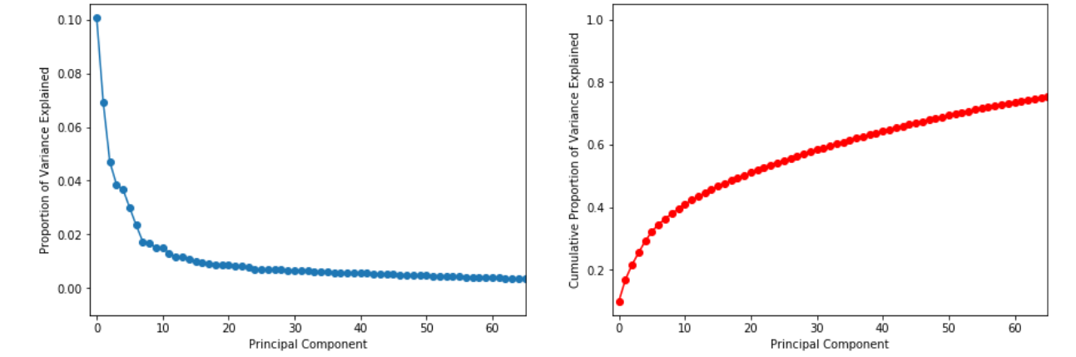
PCA
PCA
Screen Plot (PVE)
Cumulative PVE

Slide 23
Feature Engineering
SECTION 5

Slide 24

Feature Engineering – Primary table
Feature Engineering
Percentage of the loan annuity relative to a client's income using AMT_ANNUITY and AMT_INCOME_TOTAL
Length of the payment in years using AMT_ANNUITY and AMT_INCOME_TOTAL
Percentage of the days employed relative to the client's age (after imputing anomalous values in 'DAYS_EMPLOYED’)
Percentage of the goods price relative to the loan credit amount using AMT_GOODS_PRICE and AMT_CREDIT
Income per family member based on CNT_FAM_MEMBERS.
Total number of enquiries to Credit Bureau by adding individual counts from day, week, month and year.

Slide 25

Feature Engineering – Previous Application table
Feature Engineering
Group by client ID and calculate all aggregate statistics
Count of previous approved applications
Count of previous rejected applications
Difference between applied and approved credit
Aggregating AMT_ANNUNITY and AMT_APPLICATION
Prev_GOODS_PRICE_CREDIT_PERCENT: percentage of goods price relative to the loan credit amount
Prev_CREDIT_APP_PERCENTAGE: percent of credit granted relative to loan applied for
Calculate privileged interest rates, termination days, and last days due after application

Slide 26

Feature Engineering – Installment Payments table
Feature Engineering
Difference between the prescribed and actual installment amount.
Difference between the prescribed and actual days of repayment.
Percentage of amount paid relative to the installment.
Percentage of days paid relative to days installment.
Percentage of the installment difference relative to the amount.
Installment days paid late and overpaid.

Slide 27

Feature Engineering – Credit Card and POS Balance tables
Feature Engineering
Credit card balance dataset:
Credit utilization: the ratio of monthly balance and credit limit
Total number of days past due (w/tolerance) for all previous credits.
A total count of all drawings of all types.
The percentage of amount for a number of features relative to credit limit:
All current types of drawings
Payments and current payments
Receivable and receivable principal
POS_CASH_balance dataset:
Percent of remaining installment
The number of installment days remaining
Total number of days of credit past due

Slide 28

Feature Engineering – Bureau Tables
Feature Engineering
Over 85% of consumers have data in Bureau dataset
Over 600,000 instances of active credit, allowing us to use that subset for feature engineering
Bureau Balance contains new information on .2% of consumers, limiting its usefulness for feature engineering
Bureau dataset:
Total of active credit amount and outstanding debt for each consumer
How many days it has been since the most recent credit activity for each consumer
Percentage of each credit that is overdue
Percentage of the credit max that is overdue
Amount of credit closed

Slide 29
Feature Engineering – Summary of Features added
Feature Engineering
Table | New features
Primary table | 11
Previous Application | 8
Installment Payments | 7
Credit card balance | 8
Bureau and Bureau Balance | 6
POS_Cash balance | 3

Slide 30
Feature Selection
SECTION 6

Slide 31
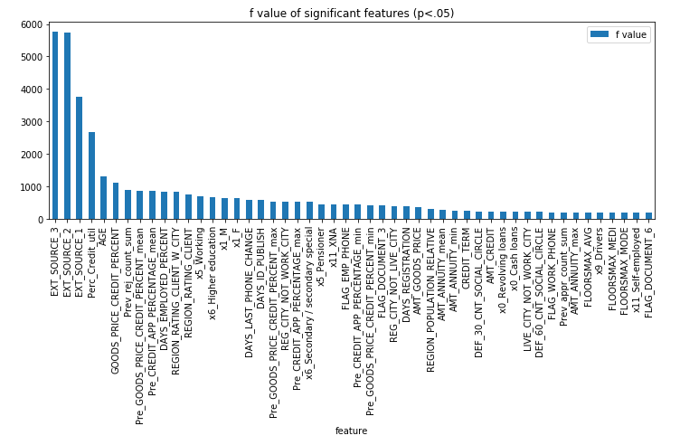
Feature Selection: p-values
ANOVA F-test
Significance level is used to determine which features contribute beyond just random noise. Set at .05.
Used two methods: the ANOVA F-test and the Chi-Squared test to generate p-values.
Most significant features identified are similar to each other and other methods.

Slide 32
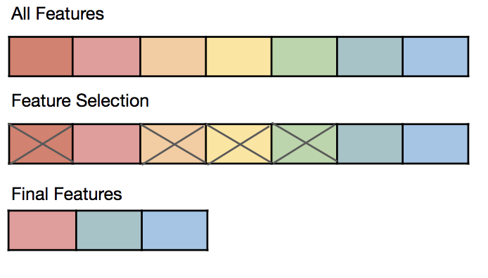
Feature Selection contd.
Feature Engineering
Reduce number of features - Input set has a total of 271 features after transforming numerical variables and one hot encoding the categorical variables.
Random Forest Classier is used to derive the most important features from the full set of input features.
The top features from the F-test, Chi-squared test and the Decision trees ensemble classifier are to a large extent similar.
TopFeatureSelector custom class can be used to get the indices of the top features which can directly be fed into a pipeline.
Pipeline with feature selection and the estimator is created to test with different inputs for number of features to be used in the final model.

Slide 33
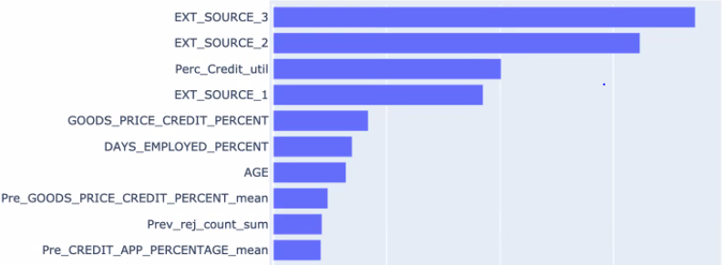
Feature Selection – Top 10 important features
Feature Selection

Slide 34
Baseline model
SECTION 7

Slide 35
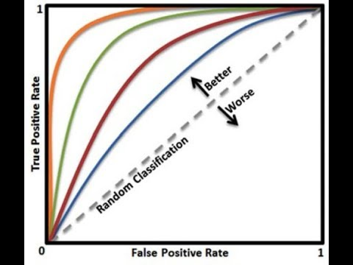
Baseline Model
Baseline Model:
Evaluation Metrics
Accuracy
ROC_AUC
Logistic Regression
with 150 Important Features
Notes:
We used accuracy and ROC_AUC(Area under the ROC Curve) as evaluation metrics. Since we have unbalanced target label, it is better use ROC_AUC. Higher the AUC, better the model is at distinguishing between label 0 and label 1.
After feature engineering, we selected top 150 most important features and tried logistic regression as our baseline model. We got Valid AUC at 0.7610.

Slide 36
Model Comparison
SECTION 8

Slide 37
Model Comparison
Model Comparision
Baseline Model with 150 Important Features - Logistic Regression
Significance test with Hyperparameter tuning with following:
XGBClassifier
GradientBoostingClassifier
Support Vector
Stochastic GD
RandomForest

Slide 38
Model Comparison – Significance Test results
Model Comparison
GridSearchCV
Almost all models are significantly better than the baseline Logistic regression model with XGBoost showing best AUC score.
Notes:
After grid search with 20% of data, we found XGB is the best model ,with parameters as following: colsample_bytree: 0.6, gamma: 1.5, max_depth: 3, min_child_weight: 5, subsample: 0.6. with p-value = 0, we can say XGB is significantly different with the baseline model (Logistic Regression).

Slide 39
Deep Learning
Model Comparison
Deep Learning models with different layer size and neurons have been evaluated
Notes:
We experimented on different deep learning models. By adjusting input features, hidden layer numbers, optimizer and batch size, we did more than 30 experiments in total, the best valid AUC is 0.7660 with input dimention 150, hidden layer 32-16-8 and adagrad as optimizer.

Slide 40
Best Models
SECTION 9

Slide 41
Best Models
CatBoost vs XGBoost Classifiers

Slide 42
Conclusion
SECTION 10

Slide 43
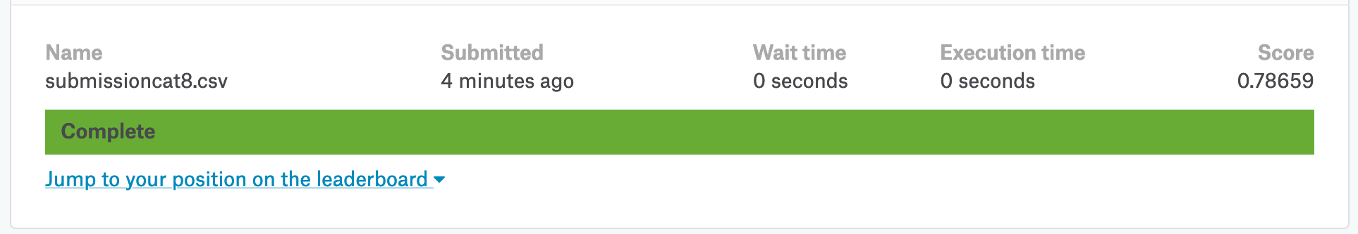
Kaggle Score:
Kaggle Score
Phase 1: 60 Features, Logistic Regression
Phase 2: 150 Features, XGBoost
Phase 3: 328 Features, CatBoost
Rank: 3518
Notes:
In Phase 1, with hand delected 60 features and logistic regression, we got Kaggle score at 0.75252.
In phase 2, we added some new features, added iterative imputer pipeline for top 4 most correlated features with 'EXT_SOURCE_3’, and conducted feature selection by random forest most important features. With top 150 most important features, XGB performed best with Kaggle score 0.76216.
Phase 3, we added even more new features and added imputater pipeline for selected features and imputed them by ‘median’. We also found CatBoost outperformed XGBoost. With CatBoost, Kaggle score increased up to 0.78659.

